Slide 1
Closest Pair of Points
CS208
by wwy

Slide 2
1 Dim
Brute Force
O(kn^2)
2 Dim
closest pair of points
divid and conquer
3 Dim
O(nlogn)
KD tree
K Dim
k>20
ball tree

Slide 3
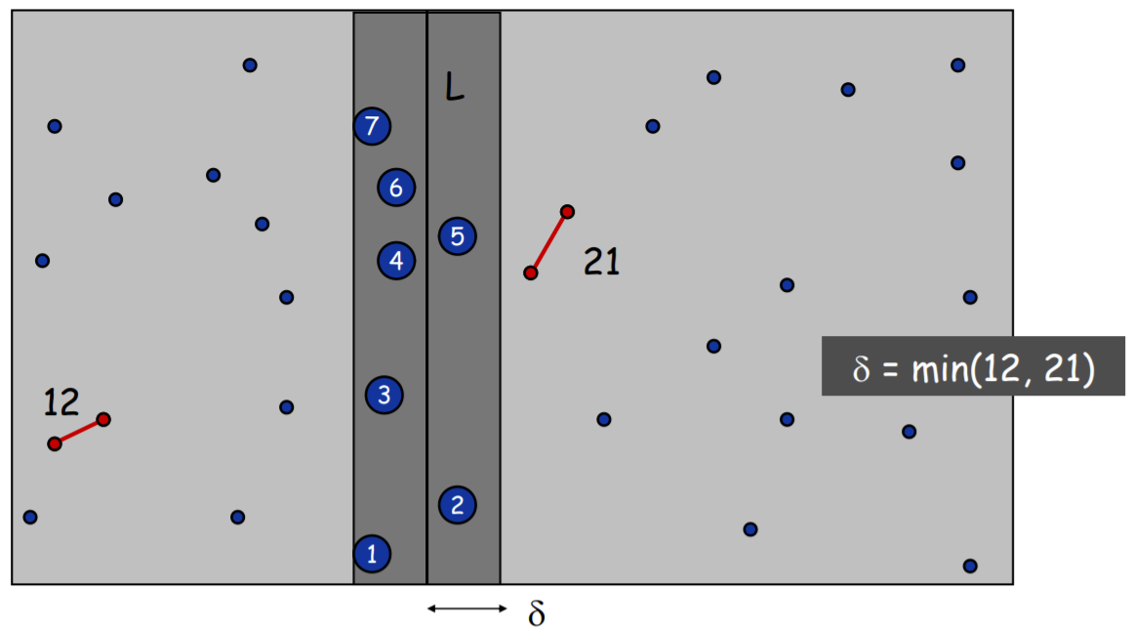
divid and conquer

Slide 4
Code
def Closest_pair(points)
length=points.length // get length of array
qsort(points,points+length,x) // sort by x-axis
//cal closest pair and its dis
ClosestPair(Point points[], int length, Point &a, Point &b)
END
def ClosestPair(Point points[], int length, Point &a, Point &b)
// divid points to 2 sub sets
if length< 2
return infinite
else if length = 2
return distance(points[0],points[1])
else // when length>=3
mid = points.mid // get middle line
pts1 = points(<=mid) // store two sub points set
pts2 = points(>mid)
// divide-and-conquer, left sub set
d1 = ClosestPair(pts1, length / 2, a1, b1);
// divide-and-conquer, right sub set
d2 = ClosestPair(pts2, length - length / 2, a2, b2);
d = min(d1,d2)
// merge
d_min=d
pts3 = points(abs(x-mid<=d) // points in interval [mid-d, mid+d]
for(each points pair : pits3)
d_pt3 = distance of points pair
if d_pt3<d_min
renew a and b;
renew d_min=d
END
Notes:
c++ code，仅供参考
#include <ctime>
#include <cmath>
#include <iostream>
#include <algorithm>
using namespace std;
#define INFINITE_DISTANCE 65535 // 无限大距离
#define COORDINATE_RANGE 100.0 // 横纵坐标范围为[-100,100]
#ifndef Closest_pair
typedef struct Point
{// 二维坐标上的点Point
double x;
double y;
}Point;
double Distance(Point a, Point b)
{//平面上任意两点对之间的距离公式计算
return sqrt((a.x - b.x)*(a.x - b.x) + (a.y - b.y)*(a.y - b.y));
}
bool compareX(Point a, Point b)
{//自定义排序规则：依照结构体中的x成员变量升序排序
return a.x < b.x;
}
bool compareY(Point a, Point b)
{//自定义排序规则：依照结构体中的x成员变量升序排序
return a.y < b.y;
}
float ClosestPair(Point points[], int length, Point &a, Point &b)
{// 求出最近点对记录，并将两点记录再a、b中
double distance; //记录集合points中最近两点距离
double d1, d2; //记录分割后两个子集中各自最小点对距离
int i = 0, j = 0, k = 0, x = 0; //用于控制for循环的循环变量
Point a1, b1, a2, b2; //保存分割后两个子集中最小点对
if (length < 2)
return INFINITE_DISTANCE; //若子集长度小于2，定义为最大距离，表示不可达
else if (length == 2)
{//若子集长度等于2，直接返回该两点的距离
a = points[0];
b = points[1];
distance = Distance(points[0], points[1]);
}
else
{//子集长度大于3，进行分治求解
Point *pts1 = new Point[length]; //开辟两个子集
Point *pts2 = new Point[length];
sort(points, points + length, compareX); //调用algorithm库中的sort函数对points进行排序，compareX为自定义的排序规则
double mid = points[(length - 1) / 2].x; //排完序后的中间下标值，即中位数
for (i = 0; i < length / 2; i++)
pts1[i] = points[i];
for (int j = 0, i = length / 2; i < length; i++)
pts2[j++] = points[i];
d1 = ClosestPair(pts1, length / 2, a1, b1); //分治求解左半部分子集的最近点
d2 = ClosestPair(pts2, length - length / 2, a2, b2); //分治求解右半部分子集的最近点
if (d1 < d2) { distance = d1; a = a1; b = b1; } //记录最近点，最近距离
else { distance = d2; a = a2; b = b2; }
//merge - 进行子集合解合并
//求解跨分割线并在δ×2δ区间内的最近点对
Point *pts3 = new Point[length];
for (i = 0, k = 0; i < length; i++) //取得中线2δ宽度的所有点对共k个
if (abs(points[i].x - mid) <= distance)
pts3[k++] = points[i];
sort(pts3, pts3 + k, compareY); // 以y排序矩形阵内的点集合
for (i = 0; i < k; i++)
{
if (pts3[j].x - mid >= 0) // 只判断左侧部分的点
continue;
x = 0;
for (j = i + 1; j <= i + 6 + x && j < k; j++) //只需与有序的领接的的6个点进行比较
{
if (pts3[j].x - mid < 0)
{// 假如i点是位于mid左边则只需判断在mid右边的j点即可
x++;
continue;
}
if (Distance(pts3[i], pts3[j]) < distance)
{//如果跨分割线的两点距离小于已知最小距离，则记录该距离和两点
distance = Distance(pts3[i], pts3[j]);
a = pts3[i];
b = pts3[j];
}
}
}
}
return distance;
}
void SetPoints(Point *points, int length)
{//随机函数对点数组points中的二维点进行初始化
srand(unsigned(time(NULL)));
for (int i = 0; i < length; i++)
{
points[i].x = (rand() % int(COORDINATE_RANGE * 200)) / COORDINATE_RANGE - COORDINATE_RANGE;
points[i].y = (rand() % int(COORDINATE_RANGE * 200)) / COORDINATE_RANGE - COORDINATE_RANGE;
}
}
int main()
{
int num; //随机生成的点对个数
Point a, b; //最近点对
double diatance; //点对距离
cout << "请输入二维点对个数:";
cin >> num;
if (num < 2)
cout << "请输入大于等于2的点个数！！" << endl;
else
{
cout << endl << "随机生成的" << num << "个二维点对如下：" << endl;
Point *points = new Point[num];
SetPoints(points, num);
for (int i = 0; i < num; i++)
cout << "(" << points[i].x << "," << points[i].y << ")" << endl;
diatance = ClosestPair(points, num, a, b);
cout << endl << endl << "按横坐标排序后的点对:" << endl;
for (int i = 0; i < num; i++)
cout << "(" << points[i].x << "," << points[i].y << ")" << endl;
cout << endl << "最近点对为：" << "(" << a.x << "," << a.y << ")和" << "(" << b.x << "," << b.y << ")" << endl << "最近点对距离为：" << diatance << endl;
}
system("pause");
}
#endif // !Closest_pair

Slide 5
KD Tree Creation
binary tree
self-balance
left<right
sort by one-dim value
segment space

Slide 6
KD Tree Creation
(7,2)
x
(5,4)
9,6)
y
(2,3)
(4,7)
(8,1)

Slide 7
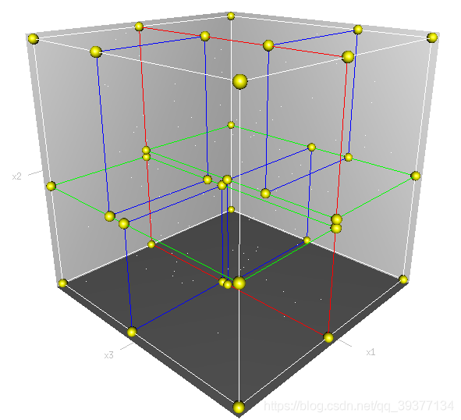
KD Tree Creation

Slide 8
KD Tree Search
 | Step | Input | Detail | Output
1 | Initial nearest distance table(NDT) | K value | # inital NDT base on K 1.distance:inf 2.node:None | NDT
2 | Backtrace path | 1. Target point(tP) 2. KD-tree | # get Backtrace path 1.tP<node, into left 2.tp>=node,into right 3.add traverse path to BPT | BPT
3 | Calculate nearest distance | 1. NDT 2. Backtrace path table(BPT) 3. P value 4. Target point | # traverse BPT 1.calculate dist between tP and node 2.update NDT 3.let max(dist) in NDT as search radius R 4.cal dist DD（dim distance） between tP and node in divide dim, and compare with R 5. DD<R, add left branch or right branch into BPT | NDT

Slide 9
eg:find three neareat points of tP(3,4.5)
initial NDT
(7,2)
x
KD-tree Node | dist
None | inf
None | inf
None | inf
(5,4)
9,6)
y
(2,3)
(4,7)
(8,1)

Slide 10
eg:find three neareat points of tP(3,4.5)
get BPT
(7,2)
x
KD-tree node | divide dim | compare(3,4.5) | which branch
(7,2) | x | 3<7 | L
(5,4) | y | 4.5>4 | R
(4,7) | x | 3<4 | L
dist
4.72
2.06
2.69
(5,4)
9,6)
y
KD-tree Node | dist
(5,4) | 2.06
(4,7) | 2.69
(7,2) | 4.74
(2,3)
(4,7)
(8,1)

Slide 11
eg:find three neareat points of tP(3,4.5)
(7,2)
x
(5,4)
9,6)
y
pseudo-code
(2,3)
(4,7)
(8,1)

Slide 12
split dim (3,4.5)
(7,2)
x
KD-tree node | divide dim | compare(3,4.5) | which branch
(7,2) | x | 3<7 | L
(5,4) | y | 4.5>4 | R
(4,7) | x | 3<4 | L
dist
4.72
2.06
2.69
(5,4)
(9,6)
y
split dim | research radius<4.72
|3-7|=4 | R->(9,6)
|4-4.5|=0.5 | L->(2,3)
|4-3|=1 | R->None
(2,3)
(4,7)
(8,1)

Slide 13
dist
4.72
2.06
2.69
(7,2)
x
KD-tree node | divide dim | compare(3,4.5) | which branch
(9,6) | y | 4.5<6 | R
(2,3) | x | 3>2 | L
dist
6.18
1.80
(5,4)
(9,6)
y
KD-tree Node | dist
(2,3) | 1.80
(5,4) | 2.06
(4,7) | 2.69
(2,3)
(4,7)
(8,1)

Slide 14
INput：Kd， //k-d tree
target //target point for search
Output：nearest， //nearest node
dist //distance between target and nearest node
1. If Kd is NULL，let dist as infinite and return
2. //binary search，create searching path
Kd_point = &Kd； //save k-d tree to Kd-point
nearest = Kd_point -> Node-data； //initial nearest node
WHILE（Kd_point）
push（Kd_point）to search_path； //search_path is a stack，storage the nodes in searching path
/***
IF Dist（nearest，target） > Dist（Kd_point -> Node-data，target）
nearest = Kd_point -> Node-data； //update nearest node
Max_dist = Dist(Kd_point，target）； //update dist between nearest node and target point
***/
s = Kd_point -> split； //determine split direction
IF target[s] <= Kd_point -> Node-data[s] //searching binary
Kd_point = Kd_point -> left；
ELSE
Kd_point = Kd_point ->right；
nearest = last leaf node in search_path； //Notice：do not compare nearest node during searching binary, this part has been commented
Max_dist = Dist（nearest，target）； //let last leaf node as nearest node before backtrace directly
3. //backtrace search
WHILE（search_path != NULL）
back_point = search_path.pop()； //get a node from search_path
s = back_point -> split； //determine split direction
IF Dist（target[s]，back_point -> Node-data[s]） < Max_dist //judge which branch should be pushed in stack
IF target[s] <= back_point -> Node-data[s]
Kd_point = back_point -> right； //if target located in left，right branch should in
ELSE
Kd_point = back_point -> left; //if target located in right，left branch should in
search_path.push(Kd_point)；
IF Dist（nearest，target） > Dist（Kd_Point -> Node-data，target）
nearest = Kd_point -> Node-data； //update nearest node
Min_dist = Dist（Kd_point -> Node-data,target）； //update dist between nearest node and target point
pseudo-code
Notes:
// c++ code, 仅供参考
#include <iostream>
#include <vector>
#include <algorithm>
#include <string>
#include <cmath>
using namespace std;
const int data[6][2] = { {2,3},{5,4},{9,6},{4,7},{8,1},{7,2} };
struct KdTree {
vector<double> root;
KdTree* parent;
KdTree* leftChild;
KdTree* rightChild;
//默认构造函数
KdTree() { parent = leftChild = rightChild = NULL; }
//判断kd树是否为空
bool isEmpty()
{
return root.empty();
}
//判断kd树是否只是一个叶子结点
bool isLeaf()
{
return (!root.empty()) &&
rightChild == NULL && leftChild == NULL;
}
//判断是否是树的根结点
bool isRoot()
{
return (!isEmpty()) && parent == NULL;
}
//判断该子kd树的根结点是否是其父kd树的左结点
bool isLeft()
{
return parent->leftChild->root == root;
}
//判断该子kd树的根结点是否是其父kd树的右结点
bool isRight()
{
return parent->rightChild->root == root;
}
};
template<typename T>
vector<vector<T> > Transpose(vector<vector<T> > Matrix)
{
unsigned row = Matrix.size();
unsigned col = Matrix[0].size();
vector<vector<T> > Trans(col, vector<T>(row, 0));
for (unsigned i = 0; i < col; ++i)
{
for (unsigned j = 0; j < row; ++j)
{
Trans[i][j] = Matrix[j][i];
}
}
return Trans;
}
template <typename T>
T findMiddleValue(vector<T> vec)
{
sort(vec.begin(), vec.end());
auto pos = vec.size() / 2;
return vec[pos];
}
//构建kd树
void buildKdTree(KdTree* tree, vector<vector<double> > data, unsigned depth)
{
//样本的数量
unsigned samplesNum = data.size();
//终止条件
if (samplesNum == 0)
{
return;
}
if (samplesNum == 1)
{
tree->root = data[0];
return;
}
//样本的维度
unsigned k = data[0].size();
vector<vector<double> > transData = Transpose(data);
//选择切分属性
unsigned splitAttribute = depth % k;
vector<double> splitAttributeValues = transData[splitAttribute];
//选择切分值
double splitValue = findMiddleValue(splitAttributeValues);
//cout << "splitValue" << splitValue << endl;
// 根据选定的切分属性和切分值，将数据集分为两个子集
vector<vector<double> > subset1;
vector<vector<double> > subset2;
for (unsigned i = 0; i < samplesNum; ++i)
{
if (splitAttributeValues[i] == splitValue && tree->root.empty())
tree->root = data[i];
else
{
if (splitAttributeValues[i] < splitValue)
subset1.push_back(data[i]);
else
subset2.push_back(data[i]);
}
}
//子集递归调用buildKdTree函数
tree->leftChild = new KdTree;
tree->leftChild->parent = tree;
tree->rightChild = new KdTree;
tree->rightChild->parent = tree;
buildKdTree(tree->leftChild, subset1, depth + 1);
buildKdTree(tree->rightChild, subset2, depth + 1);
}
//逐层打印kd树
void printKdTree(KdTree* tree, unsigned depth)
{
for (unsigned i = 0; i < depth; ++i)
cout << "\t";
for (vector<double>::size_type j = 0; j < tree->root.size(); ++j)
cout << tree->root[j] << ",";
cout << endl;
if (tree->leftChild == NULL && tree->rightChild == NULL)//叶子节点
return;
else //非叶子节点
{
if (tree->leftChild != NULL)
{
for (unsigned i = 0; i < depth + 1; ++i)
cout << "\t";
cout << " left:";
printKdTree(tree->leftChild, depth + 1);
}
cout << endl;
if (tree->rightChild != NULL)
{
for (unsigned i = 0; i < depth + 1; ++i)
cout << "\t";
cout << "right:";
printKdTree(tree->rightChild, depth + 1);
}
cout << endl;
}
}
//计算空间中两个点的距离
double measureDistance(vector<double> point1, vector<double> point2, unsigned method)
{
if (point1.size() != point2.size())
{
cerr << "Dimensions don't match！！";
exit(1);
}
switch (method)
{
case 0://欧氏距离
{
double res = 0;
for (vector<double>::size_type i = 0; i < point1.size(); ++i)
{
res += pow((point1[i] - point2[i]), 2);
}
return sqrt(res);
}
case 1://曼哈顿距离
{
double res = 0;
for (vector<double>::size_type i = 0; i < point1.size(); ++i)
{
res += abs(point1[i] - point2[i]);
}
return res;
}
default:
{
cerr << "Invalid method!!" << endl;
return -1;
}
}
}
//在kd树tree中搜索目标点goal的最近邻
//输入：目标点；已构造的kd树
//输出：目标点的最近邻
vector<double> searchNearestNeighbor(vector<double> goal, KdTree* tree)
{
/*第一步：在kd树中找出包含目标点的叶子结点：从根结点出发，
递归的向下访问kd树，若目标点的当前维的坐标小于切分点的
坐标，则移动到左子结点，否则移动到右子结点，直到子结点为
叶结点为止,以此叶子结点为“当前最近点”
*/
unsigned k = tree->root.size();//计算出数据的维数
unsigned d = 0;//维度初始化为0，即从第1维开始
KdTree* currentTree = tree;
vector<double> currentNearest = currentTree->root;
while (!currentTree->isLeaf())
{
unsigned index = d % k;//计算当前维
if (currentTree->rightChild->isEmpty() || goal[index] < currentNearest[index])
{
currentTree = currentTree->leftChild;
}
else
{
currentTree = currentTree->rightChild;
}
++d;
}
currentNearest = currentTree->root;
/*第二步：递归地向上回退， 在每个结点进行如下操作：
(a)如果该结点保存的实例比当前最近点距离目标点更近，则以该例点为“当前最近点”
(b)当前最近点一定存在于某结点一个子结点对应的区域，检查该子结点的父结点的另
一子结点对应区域是否有更近的点（即检查另一子结点对应的区域是否与以目标点为球
心、以目标点与“当前最近点”间的距离为半径的球体相交）；如果相交，可能在另一
个子结点对应的区域内存在距目标点更近的点，移动到另一个子结点，接着递归进行最
近邻搜索；如果不相交，向上回退*/
//当前最近邻与目标点的距离
double currentDistance = measureDistance(goal, currentNearest, 0);
//如果当前子kd树的根结点是其父结点的左孩子，则搜索其父结点的右孩子结点所代表
//的区域，反之亦反
KdTree* searchDistrict;
if (currentTree->isLeft())
{
if (currentTree->parent->rightChild == NULL)
searchDistrict = currentTree;
else
searchDistrict = currentTree->parent->rightChild;
}
else
{
searchDistrict = currentTree->parent->leftChild;
}
//如果搜索区域对应的子kd树的根结点不是整个kd树的根结点，继续回退搜索
while (searchDistrict->parent != NULL)
{
//搜索区域与目标点的最近距离
double districtDistance = abs(goal[(d + 1) % k] - searchDistrict->parent->root[(d + 1) % k]);
//如果“搜索区域与目标点的最近距离”比“当前最近邻与目标点的距离”短，表明搜索
//区域内可能存在距离目标点更近的点
if (districtDistance < currentDistance)//&& !searchDistrict->isEmpty()
{
double parentDistance = measureDistance(goal, searchDistrict->parent->root, 0);
if (parentDistance < currentDistance)
{
currentDistance = parentDistance;
currentTree = searchDistrict->parent;
currentNearest = currentTree->root;
}
if (!searchDistrict->isEmpty())
{
double rootDistance = measureDistance(goal, searchDistrict->root, 0);
if (rootDistance < currentDistance)
{
currentDistance = rootDistance;
currentTree = searchDistrict;
currentNearest = currentTree->root;
}
}
if (searchDistrict->leftChild != NULL)
{
double leftDistance = measureDistance(goal, searchDistrict->leftChild->root, 0);
if (leftDistance < currentDistance)
{
currentDistance = leftDistance;
currentTree = searchDistrict;
currentNearest = currentTree->root;
}
}
if (searchDistrict->rightChild != NULL)
{
double rightDistance = measureDistance(goal, searchDistrict->rightChild->root, 0);
if (rightDistance < currentDistance)
{
currentDistance = rightDistance;
currentTree = searchDistrict;
currentNearest = currentTree->root;
}
}
}//end if
if (searchDistrict->parent->parent != NULL)
{
searchDistrict = searchDistrict->parent->isLeft() ?
searchDistrict->parent->parent->rightChild :
searchDistrict->parent->parent->leftChild;
}
else
{
searchDistrict = searchDistrict->parent;
}
++d;
}//end while
return currentNearest;
}
int main()
{
int data[6][2] = { {2,3},{5,4},{9,6},{4,7},{8,1},{7,2} };
vector<vector<double> > train(6, vector<double>(2, 0));
for (unsigned i = 0; i < 6; ++i)
for (unsigned j = 0; j < 2; ++j)
train[i][j] = data[i][j];
KdTree* kdTree = new KdTree;
buildKdTree(kdTree, train, 0);
printKdTree(kdTree, 0);
/*
vector<bool> bsign;
double ddst = 0;
for (int i = 0; i < 6; i++)
bsign.push_back(false);
for (size_t i = 0; i < 6; i++)
{
}
*/
/**/
vector<double> goal;
goal.push_back(3);
goal.push_back(4.5);
vector<double> nearestNeighbor = searchNearestNeighbor(goal, kdTree);
vector<double>::iterator beg = nearestNeighbor.begin();
cout << "The nearest neighbor is: ";
while (beg != nearestNeighbor.end()) cout << *beg++ << ",";
cout << endl;
return 0;
}

Slide 15
THX :-)

